Slide 1
Lisbon accident evaluation: Which factors lead to accidents and wounded drivers and passengers
Fábio Oliveira
m20201057@novaims.unl.pt
Gonçalo Duarte
m20201329@novaims.unl.pt
Válter Frade
m20201052@novaims.unl.pt

Slide 2
CONTEXT
Portugal 2017-2020 - more than 30k accidents, 40k wounded and 400 deaths per year
Many factors can influence these incidents
(Road profile, atmospheric conditions, drivers, ...)
Need for DS approach to manage, transform, analyse and present results
LxDataLab challenge:
Identify high risk zones and influence of external factors in Lisbon and
Identify causes for wounded drivers/passengers

Slide 3
STRATEGY
Total of 7 datasets regarding Lisbon in 2019:
2 - accidents’ info (ANSR and RSB);
4 – Road profiles (ANSR);
1 – traffic jams (Waze).
Cleaning and agglomeration of the different data sources in order to allow 4 distinct analysis:
group accidents through a grid system to identify highest incident zones (geopandas, folium and H3: Uber’s system);
road profile features and traffic by zone and correlation to the previous analysis (spearman test);
identification of traffic jam peaks;
accident characteristics leading to wounded drivers and passengers (lasso regression).

Slide 4
STRATEGY
Expected outcomes:
Identification of high frequency accident zones (city center);
Crossroads, slopes and traffic impacting accident frequency positively;
Peak traffic during rush hours;
Driving at night and non cautious behavior can increase the likelihood of wounded people.

Slide 5
CHALLENGES
Data:
Some accidents didn’t have geolocation → creation of specific sub-dataset for geographic based analysis;
Crossroad and traffic light data were very similar → analysis of both datasets.
Grid system:
Grid resolution selection → balance between detail and generalization.
Feature engineering:
Associate accidents to traffic delays→ find the nearest traffic location close to 10 minutes before the incident.

Slide 6
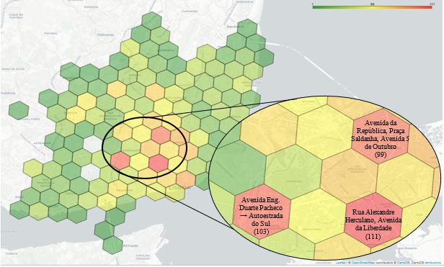
GEOGRAPHIC ANALYSIS – ZONES OF HIGHEST NUMBER OF ACCIDENTS
TOP 3 zones with the highest number of accidents:
Fig. 1: Geographic representation of the H3 hex cells, with resolution=8, colored by the number of accident occurrences that ranges from 1 (green) to 111 (red).

Slide 7
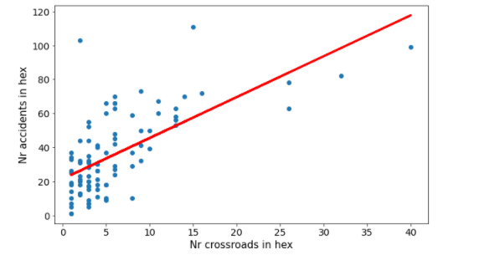
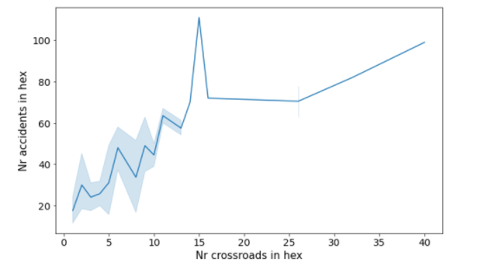
GEOGRAPHIC ANALYSIS - CROSSROADS
Moderate positive correlation
Fig. 2: Scatter plot of the number of crossroads and accidents per hex with the best linear fit (spearmen coefficient= 0.63, p-value=1.67x${10}^{−11}$) and respective line plot.
Street elevation and slope analyses didn’t show a correlation with the number of accidents.

Slide 8
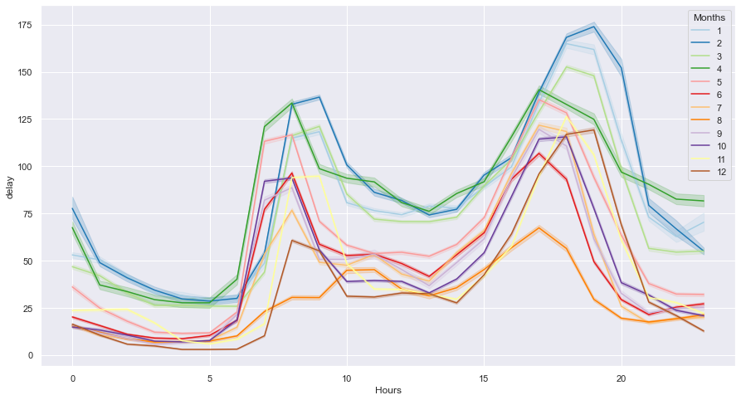
TRAFFIC CHARACTERIZATION
Highest traffic levels – January to April and during 8 and 18 o’clock
Lowest traffic levels – August and during 4 and 5 o’clock
Fig. 3: Hourly profile of Lisbon traffic grouped by month.

Slide 9
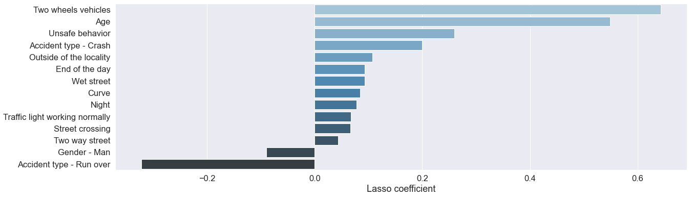
CHARACTERISTICS LEADING TO WOUNDED DRIVERS AND PASSENGERS
Positive influence – two-wheeled vehicles, age, unsafe behavior, among others
Negative influence – gender “man” and type of accident
Fig. 4: Lasso coefficients for different factors.

Slide 10




CRITIQUE
Typical Data Science study case:
data management (pandas) ;
data cleaning;
statistical analysis (SciPy);
data visualization (matplotlib, seaborn);
+ handling of geospatial data (geopandas, H3 and folium).
Challenge allowed exploratory data analysis and critical thinking

Slide 11
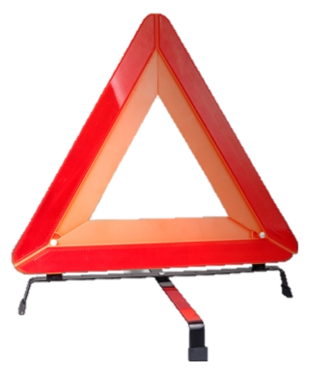
KEY FINDINGS
Classification of 3 main areas with a higher number of accidents:
Rua Alexandre Herculano + Avenida da Liberdade;
Avenida Eng. Duarte Pacheco → Autoestrada do Sul;
Avenida da República + Avenida 5 de Outubro;
2. Traffic characterization of Lisbon over 2019:
Highest traffic levels – January to April and around 8 and 18 o’clock
Lowest traffic levels – August and around 4 and 5 o’clock
3. Factors that can increase the likelihood of accidents/ wounds:
Crossroads;
Two-wheeled vehicles;
Age;
Unsafe behavior.

Slide 12
Q&A

Slide 13
CONVERSATION STARTERS
Fig. 4: Lasso coefficients for different factors.

Slide 14
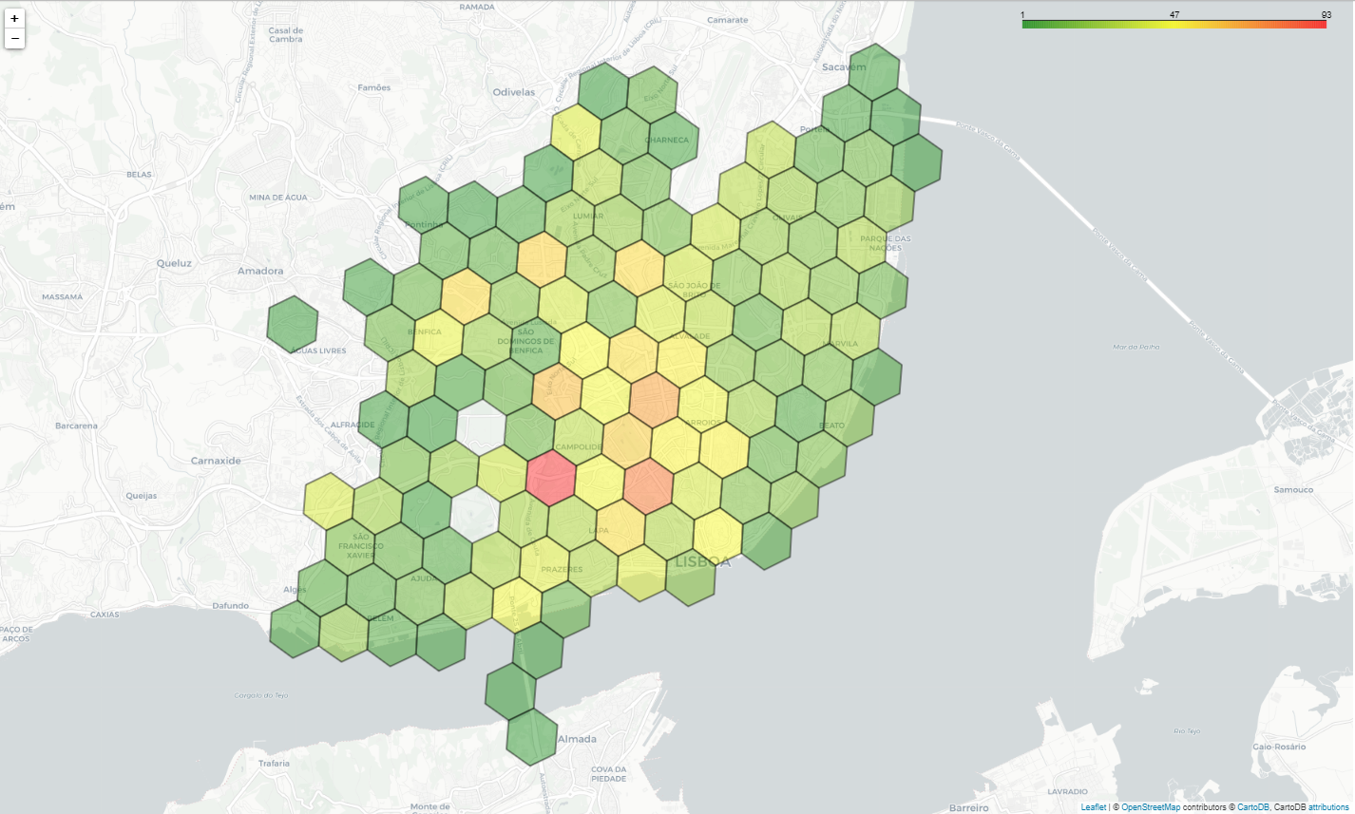
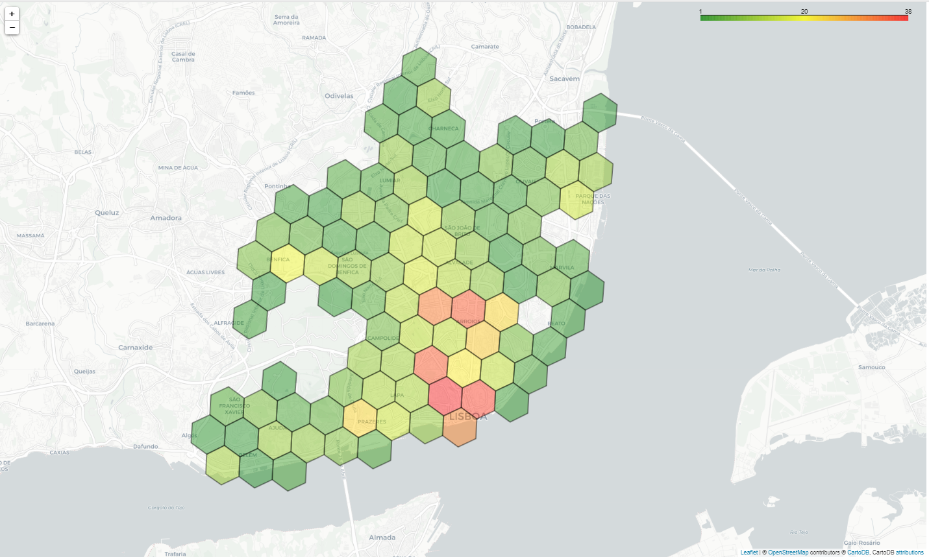
CONVERSATION STARTERS

Slide 15
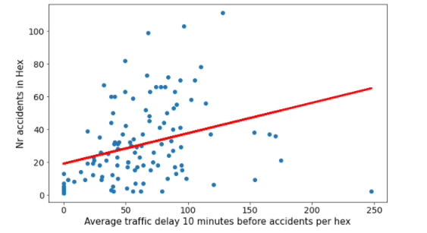
CONVERSATION STARTERS
Fig. 6: Scatterplot of the average traffic delay 10 minutes before an accident and the number of accidents per hex with the best linear fit (spearmen coefficient= 0.43, p-value=8.48x${10}^{−7}$)

Slide 16

CONVERSATION STARTERS

Slide 17

CONVERSATION STARTERS

